Slide 1



Bioinformatics approaches to understand RNA biology in the rice blast fungus
Marco Marconi
Center for Plant Biotechnology and Genomics Technical University of Madrid

Slide 2
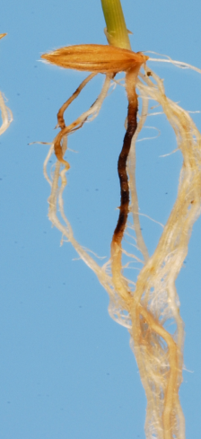
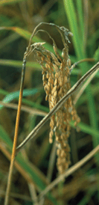
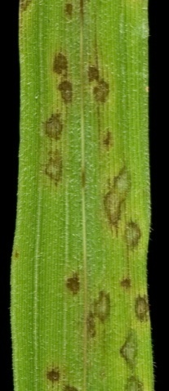
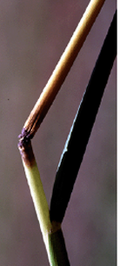
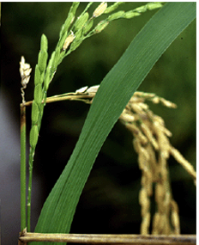
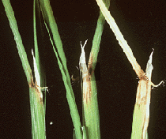
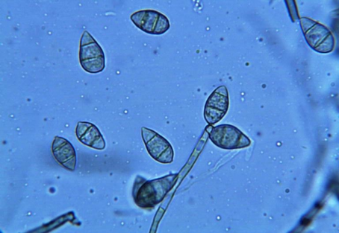
Magnaporthe oryzae is an ascomycete fungus that infects rice
root
panicle
node
leaf
Sesma&Osbourn Nature (2004)
neck
collar
Notes:
Magnaporthe oryzae is an ascomycete fungus that infects rice, it is worldwide speard and can infect different rice tissues

Slide 3
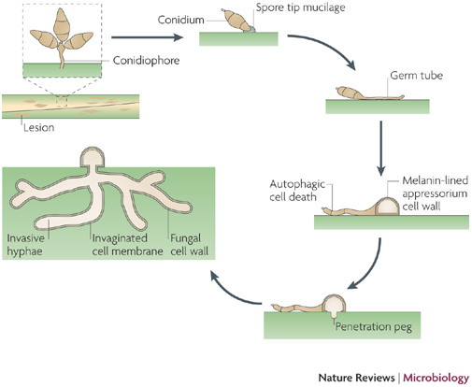
Magnaporthe oryzae life cycle
Richard A. Wilson & Nicholas J. Talbot
Nature Reviews Microbiology 7, 185-195 (March 2009)
Notes:
Magnaporthe life cycle starts with a spore landing on the plant, from where a puncturing structure called “appressorium” is developed. The fungus then penetrate the cells, reproduces and the cycle starts over again

Slide 4
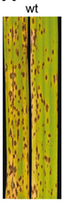
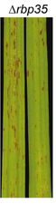
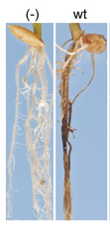
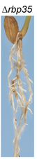
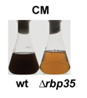
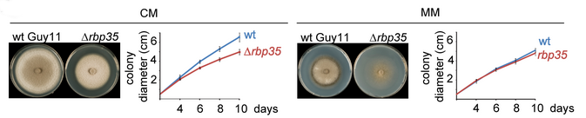
We are interested in two pathogenic-defective mutants…
Δrbp35
Marina Franceschetti , Emilio Bueno , Richard A. Wilson, Sara L. Tucker, Concepción Gómez-Mena, Grant Calder, Ane Sesma 2011
Notes:
We are interested in two mutants, one is the rbp35 gene, you can see here it’s defective in pathogenicity and development

Slide 5
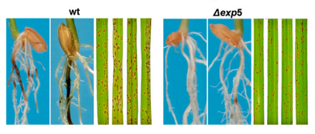
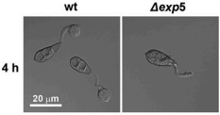
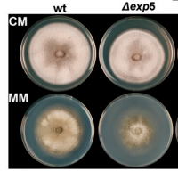
We are interested in two pathogenic-defective mutants…
Δexp5
Tucker SL1, Besi MI, Galhano R, Franceschetti M, Goetz S, Lenhert S, Osbourn A, Sesma A. 2010
Notes:
The other one in exp5, defective in pathogenicity and growing as well.

Slide 6

RBP35 is a member of the polyadenylation machinery
Pre-mRNA
CDS
Cleavage
CDS
Polyadenylation
CDS
AAAAAAAAAA
Notes:
Rbp35 is a member on the polyadenylation machinery. As you all probably already know, polyadenylation is the process where a nascent messenger RNA is cleaved and added with adenines

Slide 7
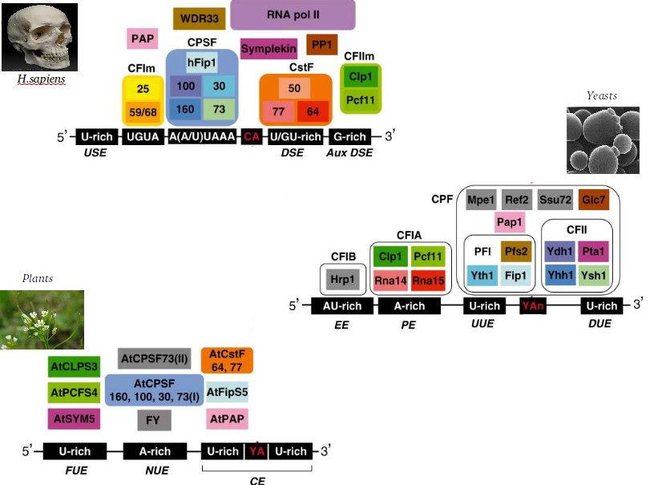
RBP35 is a member of the polyadenylation machinery
Notes:
The polyadenylation machinery is conserved in all eukariotic organisms

Slide 8
RBP35 is a member of the polyadenylation machinery
RBP35 ortholog found in animals,
but not in yeast!
!
Notes:
But the orthologs of rbp35 is not found in yeast, while it is present in animals

Slide 9
Human RBP35 orthologue bind to UGUA elements to regulate the selection of alternative polyadenylation sites (APA)
AAAAAAAAAAAAAAAAAAAA
Poly(A) site
CFI25
Rbp35
UGUA
AAAAAAAAAA
Alternative poly(A) site
Notes:
RBP35 is involved in alternative polyadenylation, a process where different polyadenylation sites can be selected on the same transcript, depending on specific binding elements

Slide 10
EXP5 is a kariopherin involved in the nuclear import/export of proteins and RNAs
METAZOAN
YEAST
double-stranded RNAs
binding proteins
tRNAs
aminoacyl-tRNA
re-export
ILF3, EF1A, JAZ…
EXP5
(metazoan)
MSN5
(yeast)
Some transcription factors
micro-RNA
precursors
RanGTP
RanGTP
NUCLEUS
Notes:
EXP5 is a kariopherin involved in the nuclear import/export. In animals it exports mostly double stranded RNAs and a few proteins, in yeast, it is involved in tRNA re-export and some transcription factors export

Slide 11
We want to shed light on the role of RBP35 and EXP5 in M.oryzae:
RNA-seq on polyadenylation sites
AAAAAAAAAAAAAAAAAAAA
AAAAAAAAAA
Notes:
So, we want to know something more about these mutants. We have performed a poyadenylation sites sequencing, in order to know the role of Rbp35 in alternative polyadenylation

Slide 12
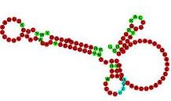


We want to shed light on the role of RBP35 and EXP5 in M.oryzae:
RNA-seq on polyadenylation sites
Small RNA-seq
?
?
?
?
Notes:
And a smallRNA sequencing, in order to know how exp5 and rbp35 regulate the non-coding population in magnaporthe oryzae

Slide 13
We want to shed light on the role of RBP35 and EXP5 in M.oryzae:
RNA-seq on polyadenylation sites
Small RNA-seq
Evolutionary analysis of polyadenylation/splicing/translation machineries
Notes:
We are also studing the evolutionary history of several protein complexes in fungi, but we are not seeing this in this today

Slide 14
We want to shed light on the role of RBP35 and EXP5 in M.oryzae:
RNA-seq on polyadenylation sites
AAAAAAAAAAAAAAAAAAAA
AAAAAAAAAA

Slide 15
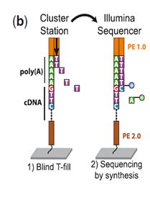
Polyadenylation sites mapping is performed with a 3’ T-filling method
(Wilkening et al., Nucleic Acids Res. 2013 , 1–8. An efficient method for genome-wide polyadenylation site mapping and RNA quantification)
Notes:
We used a library preparation method specifically implemented to sequence only polyadenilation sites

Slide 16

Sequencing details
Two strains:
WT
∆rbp35
Four nutrient conditions:
Complete medium
Minimal medium
Nitrogen starvation
Carbon starvation
3 Replicates:
#1, #2, #3
Coverage:
400x poly(A) site
Typical on-plant conditions
Julio Rodríguez-Romero

Slide 17
1. poly(A) site mapping analysis
1a. Results in wild-type
2a. Results in the ∆rbp35 mutant
2. Gene expression analysis
1a. Results in wild-type
2a. Results in the ∆rbp35 mutant
Notes:
APA -

Slide 18
1. poly(A) site mapping analysis
1a. Results in wild-type
2a. Results in the ∆rbp35 mutant
2. Gene expression analysis
1a. Results in wild-type
2a. Results in the ∆rbp35 mutant
Notes:
APA -

Slide 19

5’UTR
3’UTR
Start codon
Stop codon
Notes:
This is how a typical mapping on a gene look like

Slide 20
~14000 poly(A) sites were identified on the genome
5’UTR
3’UTR
Start codon
Stop codon

Slide 21
~14000 poly(A) sites were identified on the genome
5’UTR
3’UTR
Start codon
Stop codon
90% of the in the 3’UTR

Slide 22
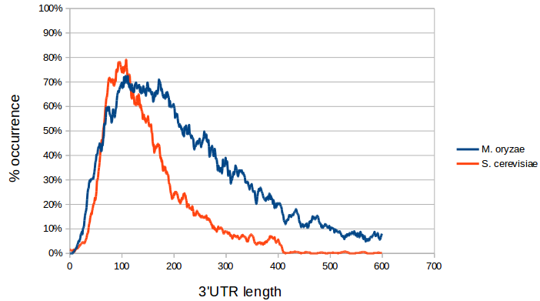
Magnaporthe oryzae 3’ UTR lengths are usually longer than Yeast

Slide 23
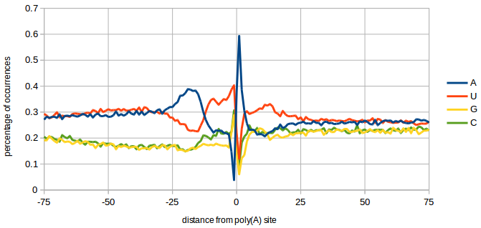
Nucleotide Profile of poly(A) site differs slightly from Yeast
YEAST
AU-rich
A-rich
U-rich
Y A
U-rich
Notes:
Also, the nucleotide profile around the poly(A) site is different. Here you can see the yeast elements well described in the literature

Slide 24
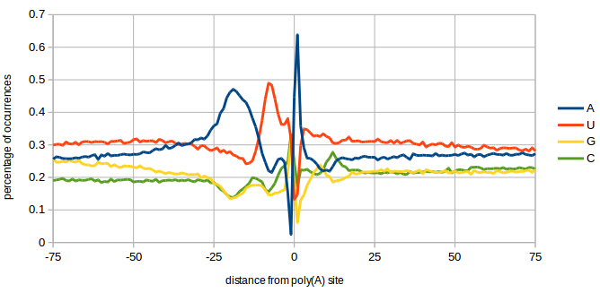
Nucleotide Profile of poly(A) site differs slightly from Yeast
YEAST
AU-rich
A-rich
U-rich
Y A
U-rich
UGUA
UAGA
A-rich
U-rich
S A
C peak
M.oryzae
Notes:
But in M.oryzae we find a different situation, With a different cut-site. The down-stream U-rich region is missing, and the upstream Au-rich region is replace by two specific elements

Slide 25
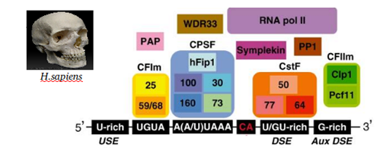
Contrary to metazoan, fungal canonical AAUAAA polyadenylation signal is highly degenerated
Very uniform
in animals

Slide 26
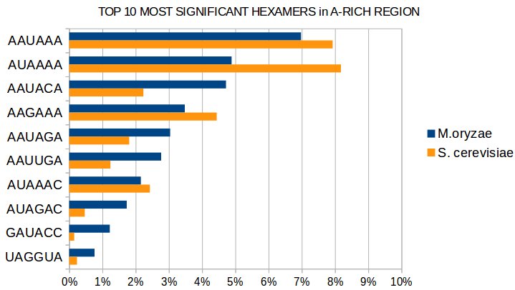
Contrary to metazoan, fungal canonical AAUAAA polyadenylation signal is highly degenerated
Very uniform
in animals
Only 7% in fungi!

Slide 27
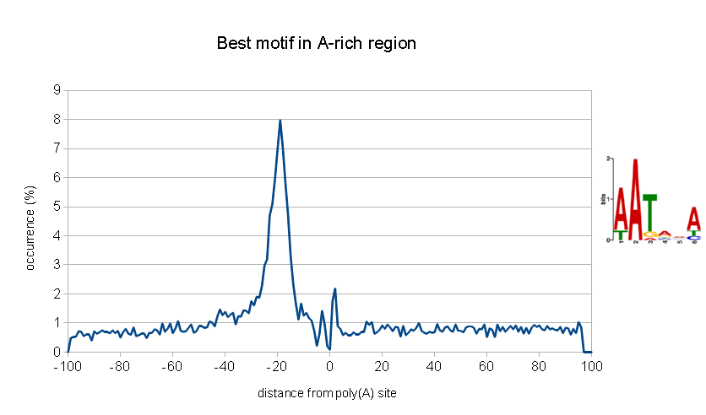
Contrary to metazoan, fungal canonical AAUAAA polyadenylation signal is highly degenerated
Very uniform
in animals
Only 7% in fungi!
Very degenerated!

Slide 28
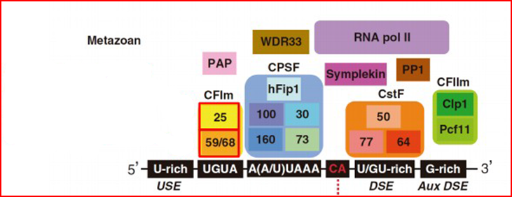
As in metazoan, M. oryzae has a UGUA motif,
together with a new UAGA motif
RBP35

Slide 29
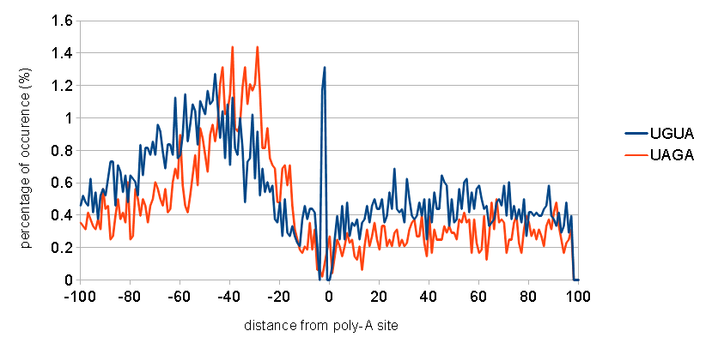
As in metazoan, M. oryzae has a UGUA motif,
together with a new UAGA motif
RBP35

Slide 30
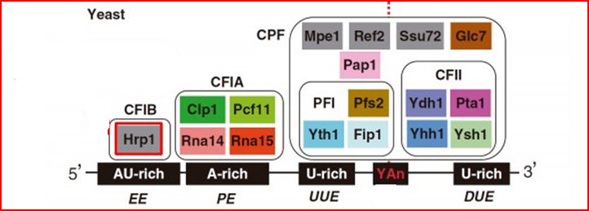
The motif bound by Hrp1 in yeast is missing is M. oryzae
M. oryzae has this
protein, Hrp1
Notes:
The polyadenylation machinery in the fungal kingdom is characterized but a protein Hrp1, known to bin AU-rich region in yeast.

Slide 31
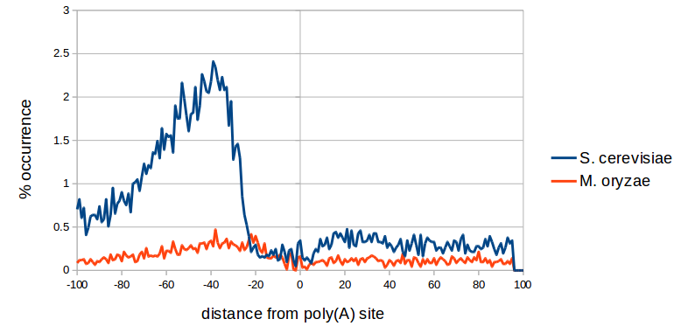
The motif bound by Hrp1 in yeast is missing is M. oryzae
But the AU-rich element it binds in yeast is missing here!
M. oryzae has this
protein, Hrp1
Notes:
But, even if this protein is present in filamentous fungi, the AU-rich element is not. So, what does Hrp1 bind?

Slide 32
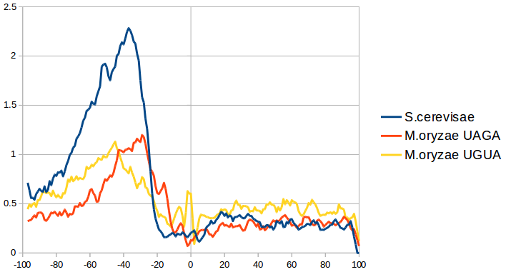
The motif bound by Hrp1 in yeast is missing is M. oryzae
But the AU-rich element it binds in yeast is missing here!
Maybe the AU-rich element is the “fusion” of UGUA and UAGA, when the CFI complex was lost in yeast
M. oryzae has this
protein, Hrp1

Slide 33
What about alternative polyadenylation?
AAAAAAAAAAAAAAAAAAAA
Different cleavage sites produce
Alternative mRNA isoforms
AAAAAAAAAA

Slide 34
What about alternative polyadenylation?
AAAAAAAAAAAAAAAAAAAA
Different cleavage sites produce
Alternative mRNA isoforms
AAAAAAAAAA
Subcellular
localisation
???
Translation
efficiency
degradation

Slide 35
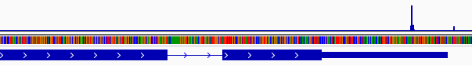
In M. oryzae ~30% of genes are alternatively polyadenylated
3’UTR

Slide 36
3’UTR
90% of APA events occur in the 3’UTR

Slide 37
80% of APA events are made of 2 alternatives only
3’UTR

Slide 38
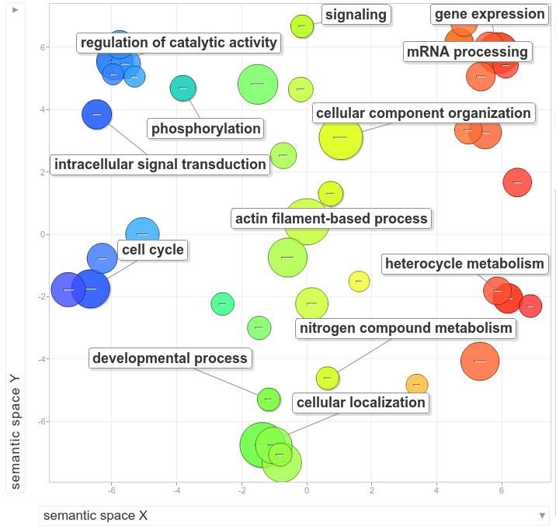
Alternative polyadenylation seems to be involved in specific biological processes

Slide 39
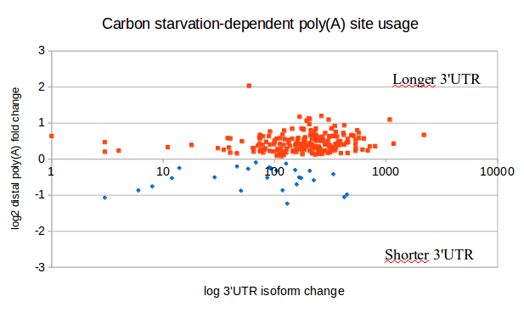
Carbon Starvation affects poly(A) selection in 455 genes
Notes:
We also found that in carbon starvation 455 genes are affected in alternative polyadenylation, most of them preferring a more distal poly(A) site

Slide 40
Carbon Starvation affects poly(A) selection in 455 genes
Complete medium
AAAAAAAAAAAAAAAAAAAA
In carbon starvation longer UTRs are usually produced
Carbon starvation
AAAAAAAAAA
Notes:
And this results in the fungus having longer 3’UTRs

Slide 41
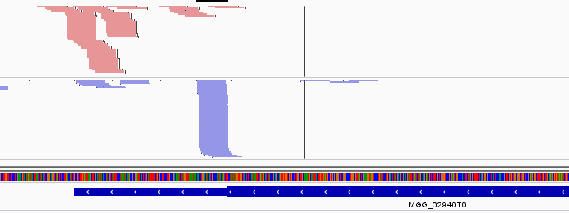
Antisense poly(A) sites are widespread
antisense
sense
3’UTR
Notes:
At least 1000 genes present some kind of antisense transcription. We don’t know the effect of this fenomenon

Slide 42
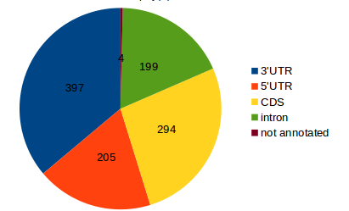
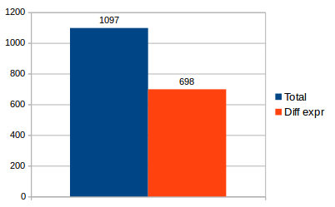
Antisense poly(A) sites are widespread
antisense
sense
3’UTR
Notes:
But the antisense transcripts are usually located in the 3’UTR, and most of them are differentially expressed between conditions, so there could be a functional significance

Slide 43
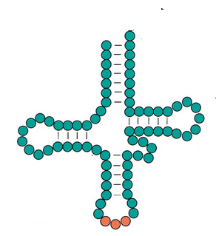
tRNAs are also polyadenylated
tRNA’s “3’UTR”
AAAAAAAAA…
Notes:
Almost strangely, tRNA are also polyadenylated. They possess a very short “3’UTR” as we can call it

Slide 44
tRNAs are also polyadenylated
tRNA’s “3’UTR”
AAAAAAAAA…
Adding
CCA
Aminoacid
Miracle
here
Notes:
And they are subsequently processed into theis final form.

Slide 45
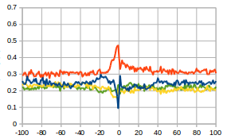
tRNAs are also polyadenylated
tRNA’s “3’UTR”
AAAAAAAAA…
Adding
CCA
Aminoacid
Miracle
here
tRNA poly(A) site
Notes:
They nucleotide profile differs from regular poly(A) sites, meaning that they probably cleaved by a different machinery

Slide 46
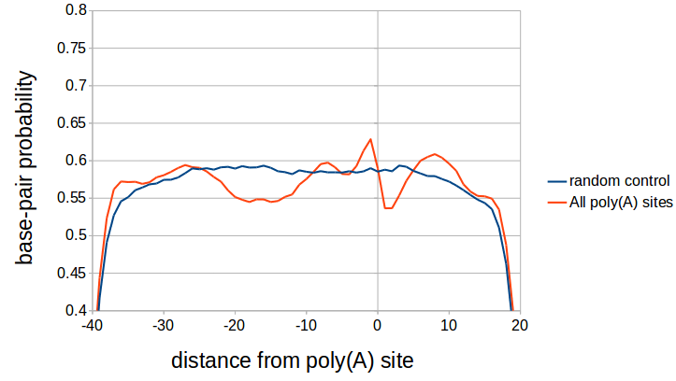
The polyadenylation site region has a defined secondary structure
Notes:
The polyadenylation site region has a defined secondary structure. On the y-axis we have the probability of a nucleotide to be bounded or not (we will se later a picture)

Slide 47
The polyadenylation site region has a defined secondary structure
The polyadenylation site is usually structured and located before a hairpin-loop

Slide 48
The polyadenylation site region has a defined secondary structure
The A-rich region is usually
not structured
The polyadenylation site is usually structured and located before a hairpin-loop

Slide 49
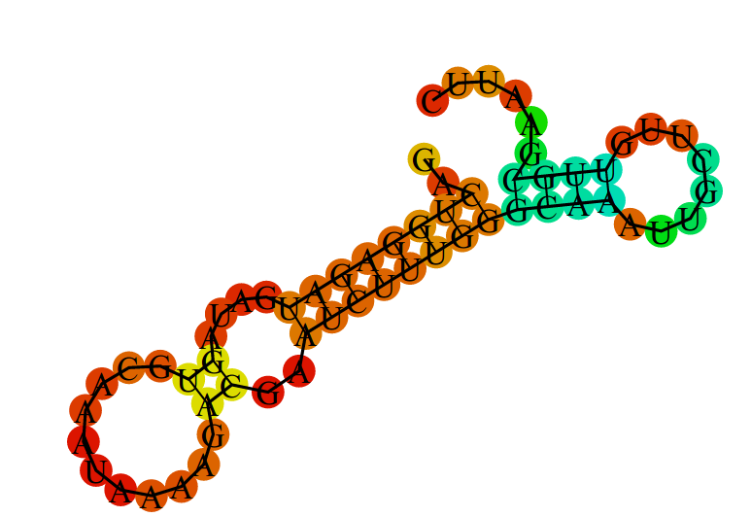
The polyadenylation site region has a defined secondary structure
The A-rich region is usually
not structured
The polyadenylation site is usually structured and located before an hairpin-loop

Slide 50
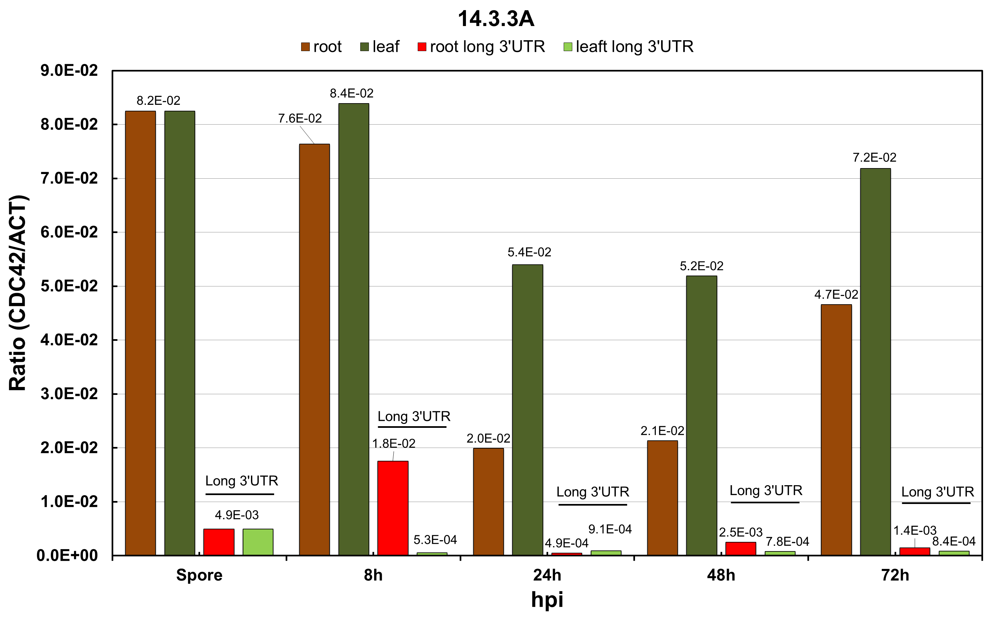
14.3.3a (MGG_01588)
3’
5’
Long 3’UTR under carbon starvation (351 nt)
CDS 1133 nt
Short 3’UTR in CM (122 nt)
5’
3’

Slide 51
Comparative poly(A) sites mapping using WT and ∆rbp35 strains in four different growth conditions
1. poly(A) site mapping analysis
1a. Results in wild-type
2a. Results in the ∆rbp35 mutant
2. Gene expression analysis
1a. Results in wild-type
2a. Results in the ∆rbp35 mutant
Notes:
APA -

Slide 52
∆rbp35 affects the overall number of Poly-A sites (generally increases)

Slide 53
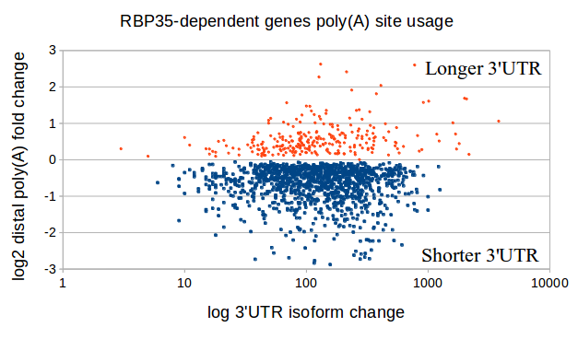
~25% of M. oryzae’s genes have a different poly(A) site usage in ∆rbp35

Slide 54
~25% of M. oryzae’s genes have a different poly(A) site usage in ∆rbp35
Wild type
AAAAAAAAAA
In the mutant, shorter UTRs are usually preferred
∆rbp35
AAAAAAAAAAAAAAAAAAAA

Slide 55
RBP35-dependent poly(A) sites are less likely to possess the canonical AAUAAA sequence
A-rich

Slide 56
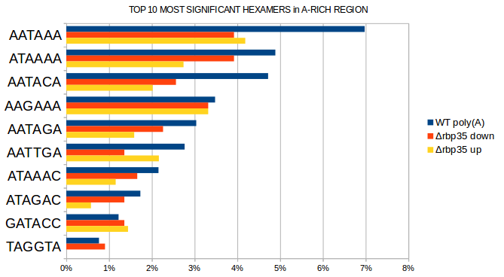
RBP35-dependent poly(A) sites are less likely to possess the canonical AAUAAA sequence
A-rich

Slide 57
UGUA motif is very enriched in down-regulated poly(A) sites in ∆rbp35
UGUA

Slide 58
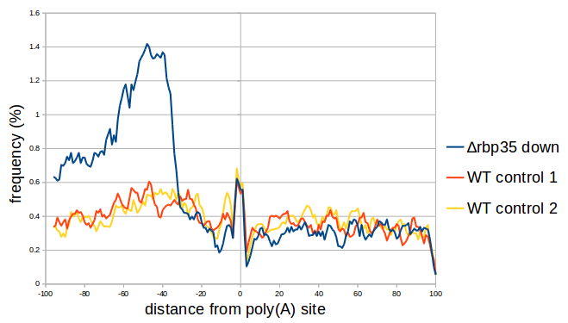
UGUA motif is very enriched in down-regulated poly(A) sites in ∆rbp35
E-value: 5.3e-103
UGUA

Slide 59
The recognition of a proper UGUA motif by Rbp35 is essential for the cleavage reaction.
Wild type strain (common situation)
Rbp35/CFI25
5’
UGUA
-45
3’
Poly(A) site
Notes:
The recognition of a proper UGUA motif by Rbp35 is essential for the cleavage reaction.

Slide 60
The recognition of a proper UGUA motif by Rbp35 is essential for the cleavage reaction.
Wild type strain (common situation)
Wild type strain (alternative poly(A) site)
Rbp35/CFI25
Rbp35/CFI25
5’
5’
UGUA
UGUA
-45
3’
-45
3’
Poly(A) site
Poly(A) site
Poly(A) site “occluded” by RBP35
Notes:
Also, Rbp35 can help to occlude an alternative poly(A) site

Slide 61
The recognition of a proper UGUA motif by Rbp35 is essential for the cleavage reaction.
Wild type strain (common situation)
Wild type strain (alternative poly(A) site)
Rbp35/CFI25
Rbp35/CFI25
5’
5’
UGUA
UGUA
-45
3’
-45
3’
Poly(A) site
Poly(A) site
The mutant
Poly(A) site “occluded” by RBP35
Rbp35/CFI25
5’
UGUA
-45
3’
Poly(A) site “revealed”
Notes:
When the protein is missing, the occluded poly(A) site becomes visible and it is cleaved

Slide 62
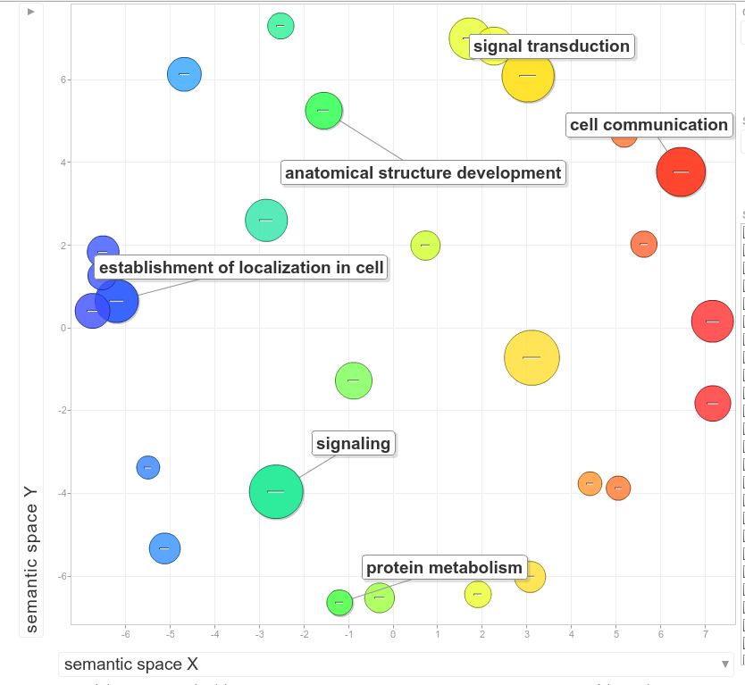
Δrbp35 dependent genes are related with specific functional groups

Slide 63
Comparative poly(A) sites mapping using WT and ∆rbp35 strains in four different growth conditions
1. poly(A) site mapping analysis
1a. Results in wild-type
2a. Results in the ∆rbp35 mutant
2. Gene expression analysis
1a. Results in wild-type
2a. Results in the ∆rbp35 mutant
Notes:
APA -

Slide 64
Comparative poly(A) sites mapping using WT and ∆rbp35 strains in four different growth conditions
1. poly(A) site mapping analysis
1a. Results in wild-type
2a. Results in the ∆rbp35 mutant
2. Gene expression analysis
1a. Results in wild-type
2a. Results in the ∆rbp35 mutant
Notes:
APA -

Slide 65
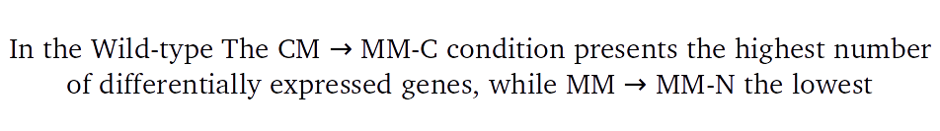
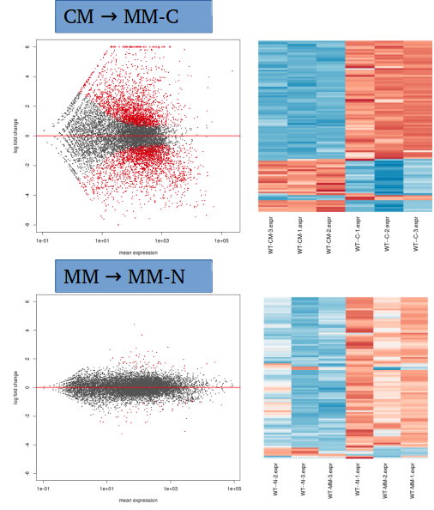
Maybe the fungus found an alternative source of nitrogen?

Slide 66
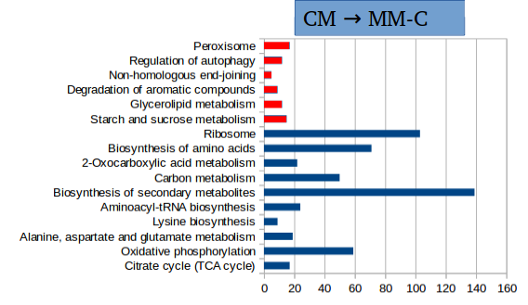

Several metabolic pathways are down regulated in carbon starvation

Slide 67
Comparative poly(A) sites mapping using WT and ∆rbp35 strains in four different growth conditions
1. poly(A) site mapping analysis
1a. Results in wild-type
2a. Results in the ∆rbp35 mutant
2. Gene expression analysis
1a. Results in wild-type
2a. Results in the ∆rbp35 mutant
Notes:
APA -

Slide 68
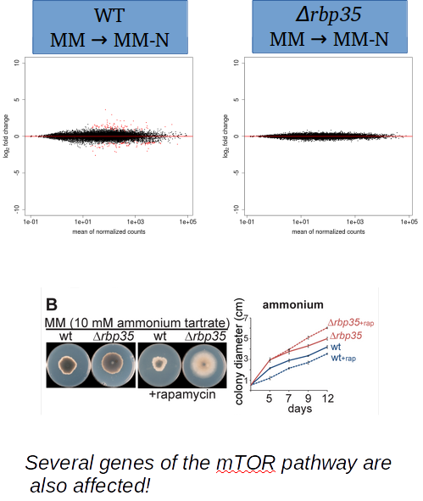
Δrbp35 seems to inhibit medium recognition in nitrogen starvation

Slide 69
We want to shed light on the role of RBP35 and EXP5 in M.oryzae:
RNA-seq on polyadenylation sites
Small RNA-seq
?
?
?
?

Slide 70


Small RNA library preparation and sequencing
Total RNA isolation
Adaptor ligation
Adriana Illana Otero,
in Norwich
RT & PCR
Size fractionation
Sequencing
Notes:
The library preparation was performed by adriana in norwich

Slide 71


HD adapters were used to reduce ligation bias
Regular smallRNA-seq
sequencing
HD smallRNA-seq
x256 combinations
sequencing
Sorefan K1, Pais H, Hall AE, Kozomara A, Griffiths-Jones S, Moulton V, Dalmay T. 2012

Slide 72
Sequencing details
Three strains:
WT
∆exp5
∆rbp35
3 Replicates:
#1, #2, #3

Slide 73
Let’s see what we have on the annotated genome…..

Slide 74
Only 25% of reads map on the genome

Slide 75
∆rbp35 reads align slighty more

Slide 76
Most of genome sRNA loci (4131) are located in mRNAs

Slide 77
In ∆exp5, a lot of protein-coding related loci are down regulated

Slide 78
In ∆rbp35, a lot of transposable elements related loci are down regulated, and many ncRNA related loci are up regulated

Slide 79
…and this was 25% of the story, so let’s forget about the annotated genome for a while…

Slide 80
The majority of reads are of unknown origin
They don’t align against any database!

Slide 81
Many reads map to unknown ESTs non-aligning on the genome!
???

Slide 82
So, what’s happening in the mutants?

Slide 83
∆rbp35 aligns more small RNA from protein coding genes

Slide 84
We cannot classify most of the changes in ∆exp5

Slide 85
We have more luck with ∆rbp35

Slide 86
We don’t know what they are… but at least, how do they look like?

Slide 87
We obtained reads in the range 18-25 bp

Slide 88
∆rbp35 reads look kind of shorter, and ∆exp5 reads are missing a peak at 14 bp…

Slide 89
In ∆exp5 we observe the down-regulation of very short fragments
Mostly rRNA and protein-coding genes
Mostly, the mysterious naESTs

Slide 90
In ∆exp5 we observe the down-regulation of very short fragments
The infamous naESTs again

Slide 91
In ∆rbp5 we observe a peak of up-regulated 19 nt sequences
Transposable elements, protein-coding genes and naEST

Slide 92
There is an overall U preference as 1st nucleotide, in reads with length 16-26 nt
Mainly in protein-coding genes and transposable elements

Slide 93

There is an overall U preference as 1st nucleotide, in reads with length 16-26 nt
Mainly in protein-coding genes and transposable elements
AGO
Certain proteins involved in RNA-interference like Argonaut have a preference for 5’ uraciles
U

Slide 94
∆rbp35 small RNAs with 1st nucleotide U-preference are up-regulated

Slide 95
There is an overall A preference as last nucleotide, in reads with length 17-29
Again, in protein-coding genes and transposable elements

Slide 96

There is an overall A preference as last nucleotide, in reads with length 17-29
Again, in protein-coding genes and transposable elements
A
But it is a post-transcriptional modification!
Also found in N.crassa:
Zhihong Xue, Haiyan Yuan, Jinhu Guo,* and Yi Liu† 2013

Slide 97
Last adenine preference is variable among mutants
Maybe that’s why it aligns better!

Slide 98
Transposable elements and naEST present a higher degree of antisense transcription…
ncRNA rRNA transposable cDNA naEST

Slide 99
…incremented in the mutants
∆rbp35
∆exp5
transposable naEST

Slide 100
A new class of protein-coding related related small RNA is found
Protein-coding gene
Unknown
smallRNA!

Slide 101
A new class of protein-coding related related small RNA is found
Protein-coding gene
Unknown
smallRNA!
Aspartyl tRNA synthase
Pre-RNA processing factor 39
GET1
Nuclear pore complex protein Nup107
Serine hydroxymethyltransferase
AP-1 complex subunit
…more…
All conserved in other filamentous fungi!
(but not yeasts)

Slide 102

A new class of protein-coding related related small RNA is found
Protein-coding gene
Unknown
smallRNA!
Aspartyl tRNA synthase
Pre-RNA processing factor 39
GET1
Nuclear pore complex protein Nup107
Serine hydroxymethyltransferase
AP-1 complex subunit
…more…
All conserved in other filamentous fungi!
(but not yeasts)

Slide 103


Acknowledgements

Slide 104

Questions?

